Slide 1

We don’t need no educator
The role of the teacher in today’s online education
Stephen Downes
NFF konferansen, 14 November 2011
Oslo, Norway

Slide 2

“…the single most important factor affecting student achievement is teachers.”
So we’re told, anyway…
http://www.epi.org/publication/books_teacher_quality_execsum_intro/
Notes:
How often do we read about the importance of teachers in education? It must be every day, it seems. We are told about "strong empirical evidence that teachers are the most important school-based determinant of student achievement" again and again.
The problem with the educational system, it is argued, is that teachers need to be held accountable. We are told we must fire incompetent teachers. Not just in the United States, but in the UK and elsewhere, the concern is that bad teachers must go.
Hanushek (1992) estimates that the difference between having a good teacher and having a bad teacher can exceed one grade-level equivalent in annual achievement growth. Likewise, Sanders (1998) and Sanders and Rivers (1996) argue that the single most important factor affecting student achievement is teachers, and the effects of teachers on student achievement are both additive and cumulative.

Slide 3

In fact there numerous factors: parental income & educational attainment, social factors & expectations, social equity, genetic predisposition…
Notes:
Students’ Inherent Characteristics, Parents’ Educational Attainment and Family Size as Predictors of Academic Achievement in Integrated Science, B. J. Ogunkola, Olatoye, R.A, Research Journal of Internatıonal Studıes - Issue 16 (September, 2010) www.eurojournals.com/rjis_16_11.pdf
Predictors and Outcomes of Physician Lifelong Learning
Mohammadreza Hojat, Ph.D. Joseph S. Gonnella, M.D. Jon J. Veloski, M.S.
jdc.jefferson.edu
etc etc etc

Slide 4
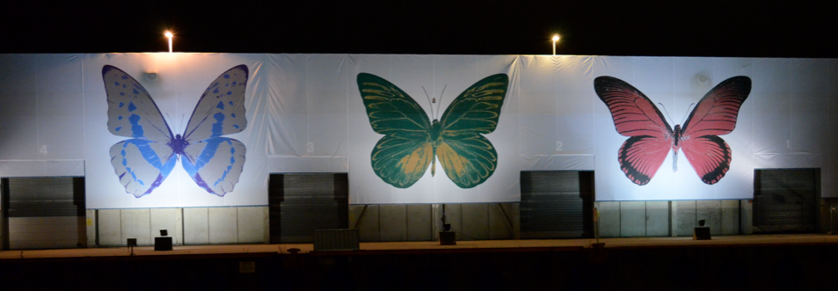

That aside, if we just look at educators, we see dramatic changes in the traditional role of the educator… as though the educator is disappearing

Slide 5
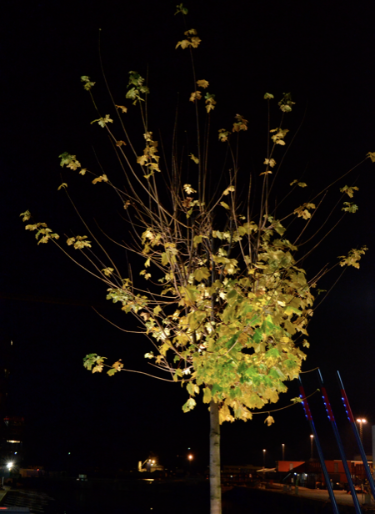

Today’s Three-fold Task:
Pull apart the roles of the educator in an online world
Identify those roles in the context of the massive open online course
Provide practical examples and applications

Slide 6
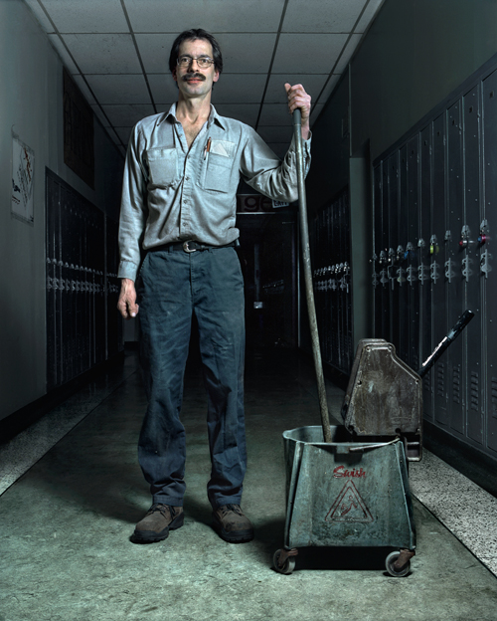
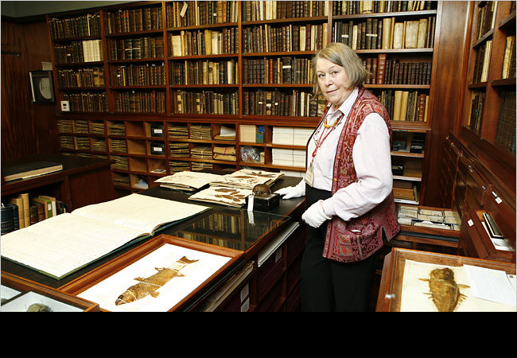
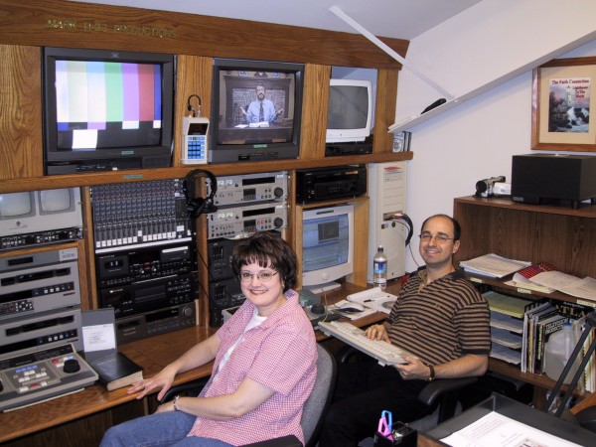
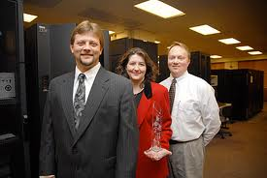
A historical trend…

Slide 7
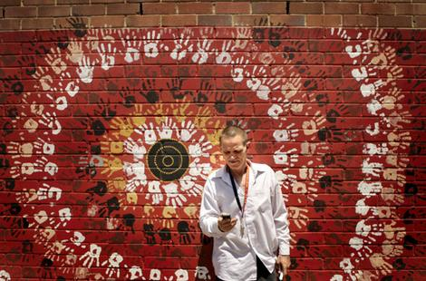
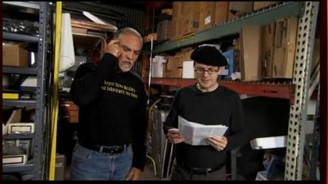

… will continue today
Notes:
Hands on … Richard Green, an indigenous-language teacher, checks his mobile-based Dharug dictionary.
Photo: Kate Geraghty
Digital solution to age-old dilemma
Sydney Morning Herald
http://www.smh.com.au/news/technology/digital-solution-to-ageold-dilemma/2008/12/18/1229189804505.html
Steve Jobs doesn't know what the iPhone can do, says Adobe
Proves Flash can run on iPhone
By Mary Branscombe
TechRadar
http://www.techradar.com/news/computing/apple/steve-jobs-doesn-t-know-what-the-iphone-can-do-says-adobe-641520

Slide 8
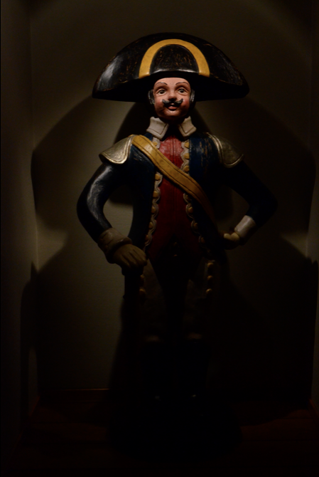
The context….
(connectivism)
Educators are no longer ‘the experts’
Learning is no longer about content transfer
Teaching takes place in an authentic environment
Learning consists of engagement, experimentation and communication

Slide 9
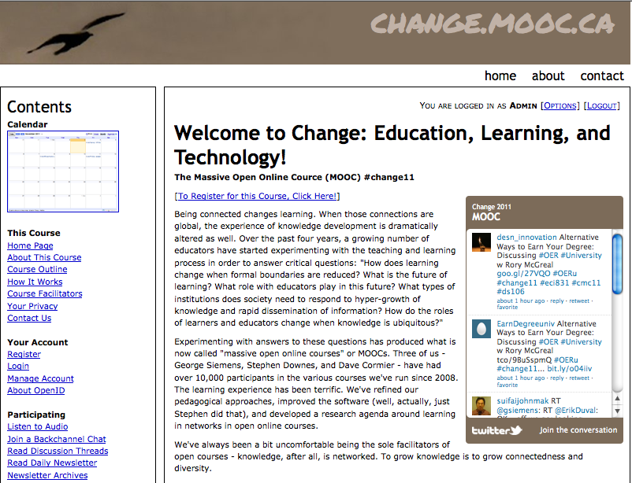
http://change.mooc.ca

Slide 10

The Roles….
Teacher as
Expert
Teacher as
Learner
Teacher as Coach
Teacher as
Designer

Slide 11

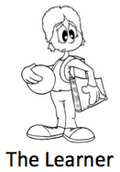
1

Slide 12
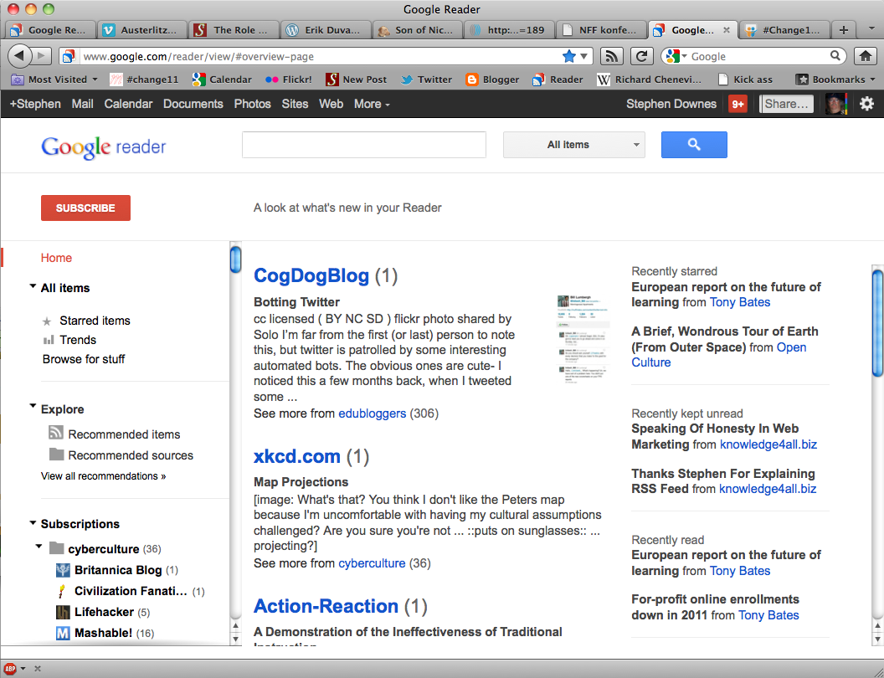
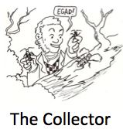
http://reader.google.com
http://www.downes.ca/opml.xml
Notes:
RSS – An Introduction to RSS for Educational Designers
OPML http://www.downes.ca/opml.xml

Slide 13
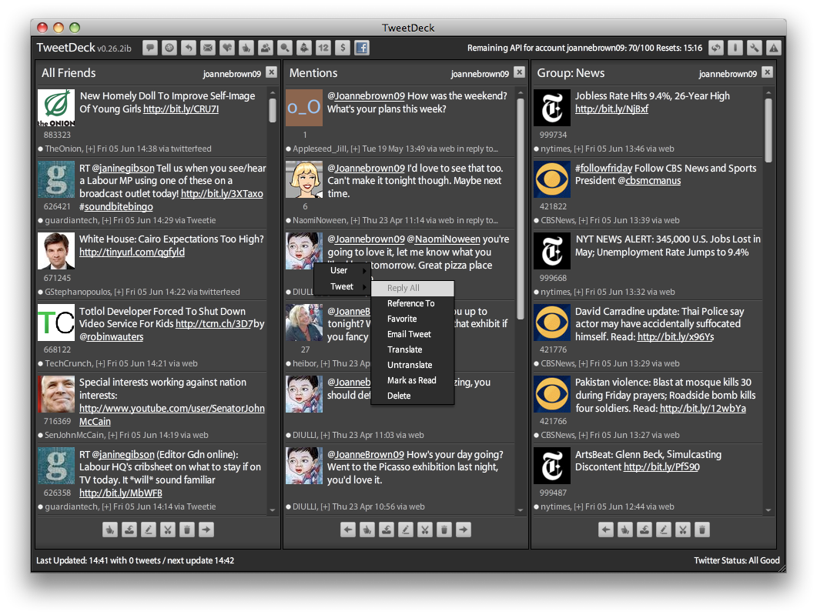

#hashtag
http://www.tweetdeck.com/
Notes:
hashtag
twitter, identi.ca
tweetdeck
Tony Hirst

Slide 14
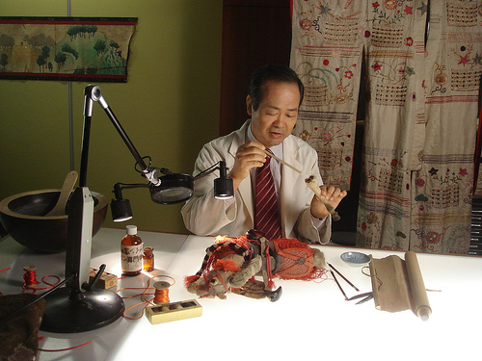
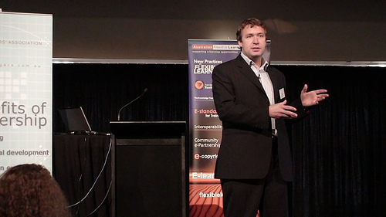
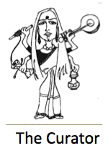
http://learnonline.wordpress.com/2007/09/20/10-minute-lecture-george-siemens-curatorial-teaching/

Slide 15

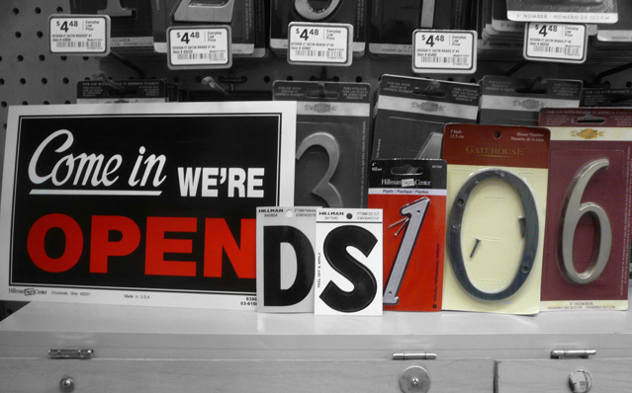
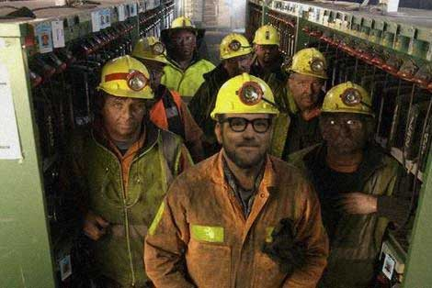
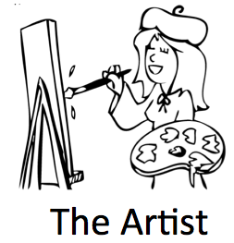
http://ds106.us/
Notes:
remix / repurpose

Slide 16
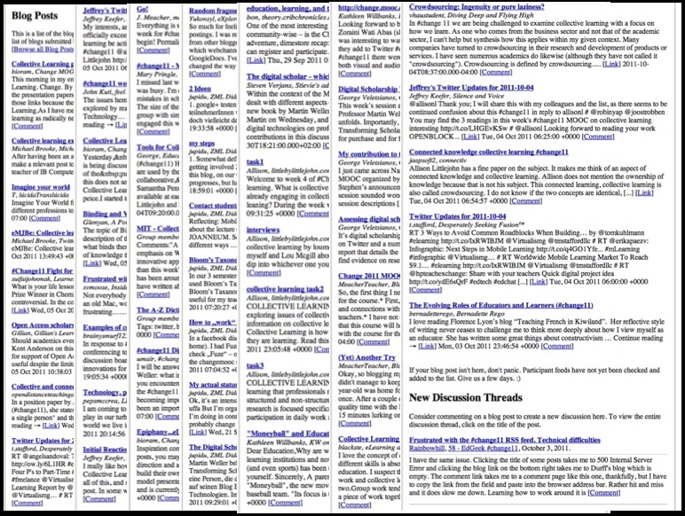

http://change.mooc.ca/newsletter.htm

Slide 17
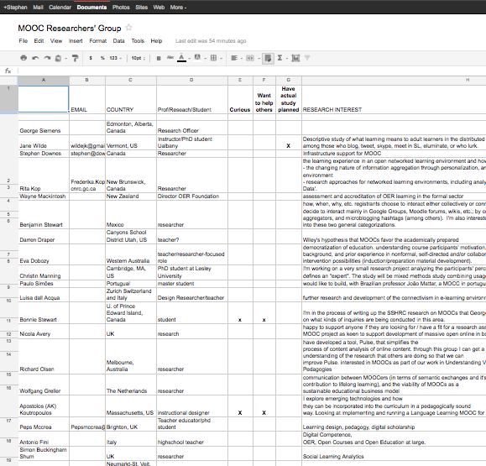
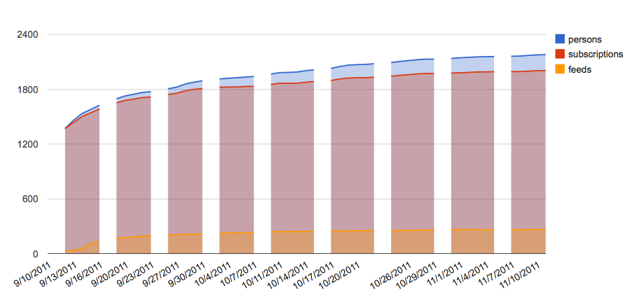

http://bit.ly/sfnEF6
Notes:
also – stats pages - https://docs.google.com/spreadsheet/ccc?key=0Aoxh9wWyk71HdGtEYXFfXzdON3Fvb3h2WHFJbTBxMkE&hl=en_US#gid=1
and
http://www.downes.ca/stats/awstats.downes.ca.html
http://change.mooc.ca/stats/awstats.change.mooc.ca.html

Slide 18

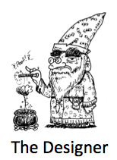
2. Designer
2

Slide 19

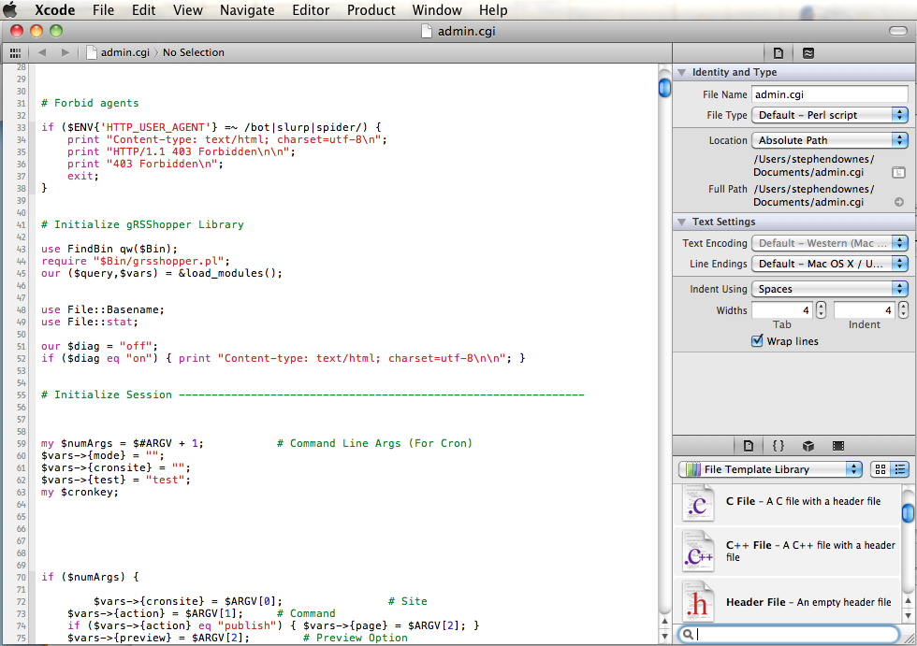
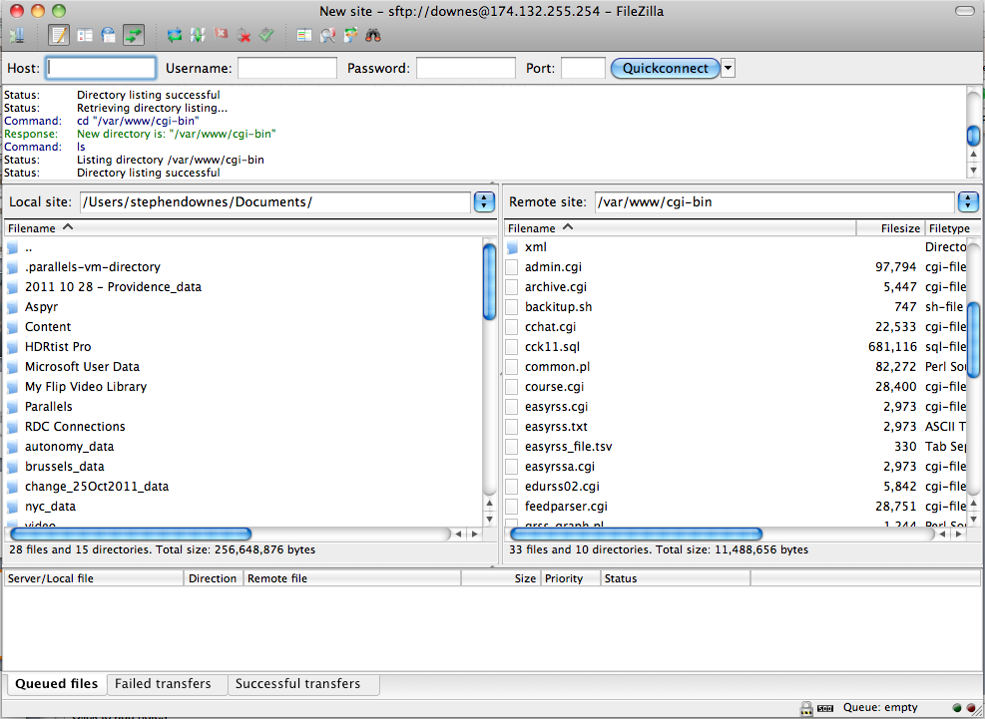
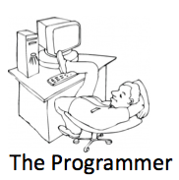
http://grsshopper.downes.ca/

Slide 20
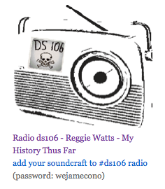
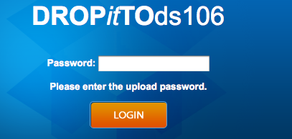
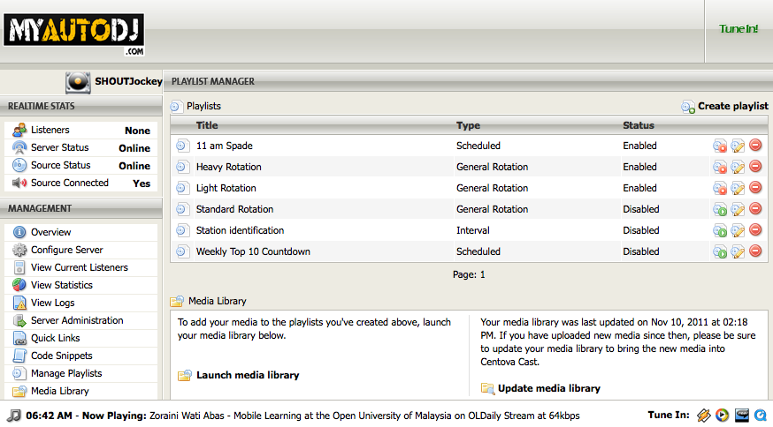

http://ds106.us/ds106-radio/
http://www.downes.ca/edradio.htm
Notes:
Grant Potter
myautodj.com
dropbox.com
dropittome.com

Slide 21
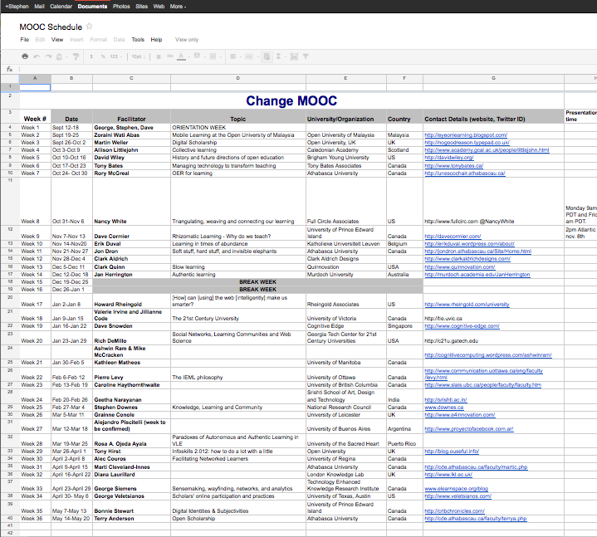

http://bit.ly/qxkXTX

Slide 22
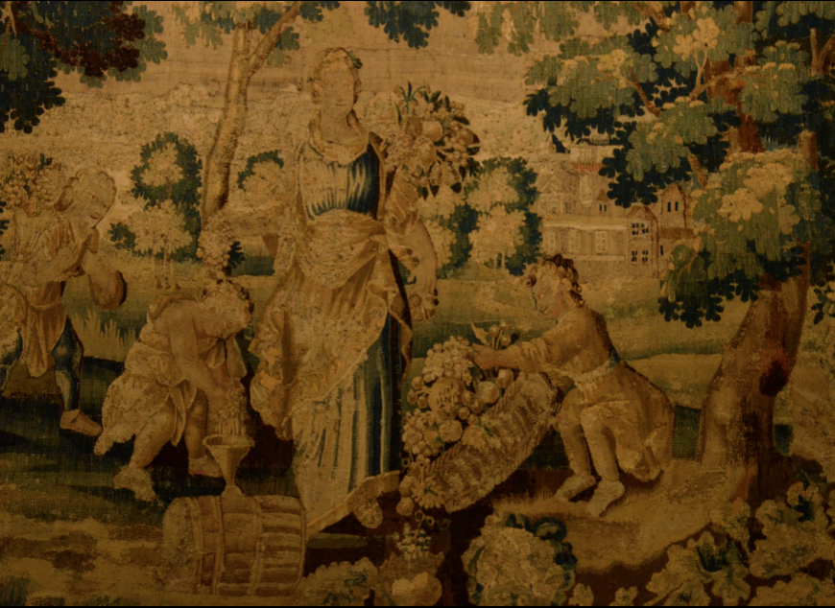
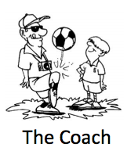
3

Slide 23
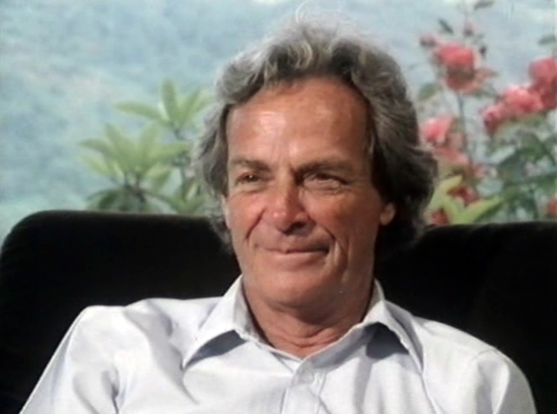
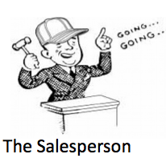
http://www.feynmanonline.com/
Notes:
Also, Salman Khan
Also, all the TED Videos

Slide 24


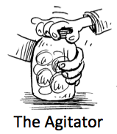
http://www.downes.ca/post/44760
Notes:
Alejandro Piscatelli
Diego Leal
etc

Slide 25
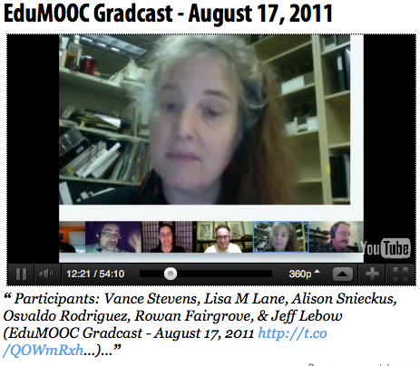
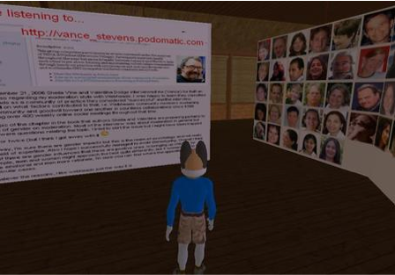
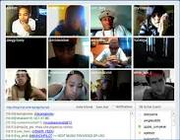

http://www.scoop.it/t/edumooc/
https://plus.google.com/
Notes:
Skype
Google hangout
Tinychat
Oovoo

Slide 26
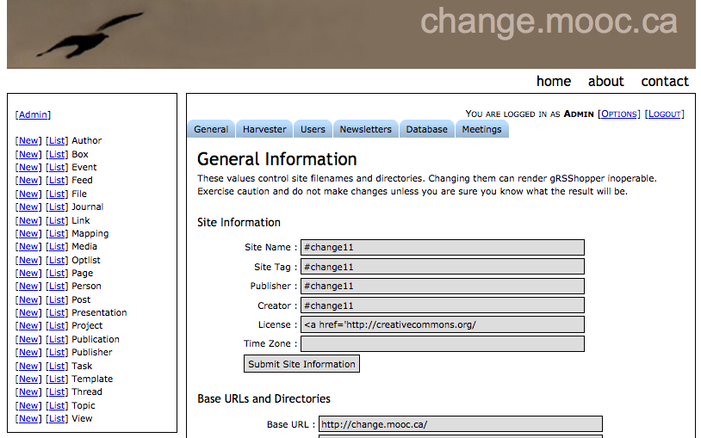
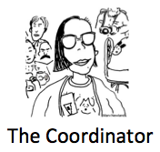
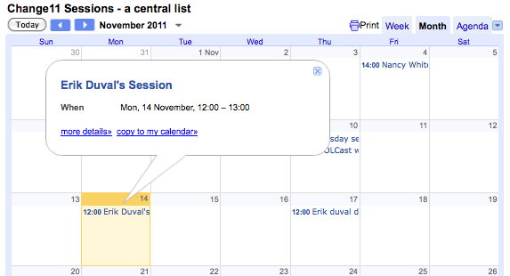

Slide 27
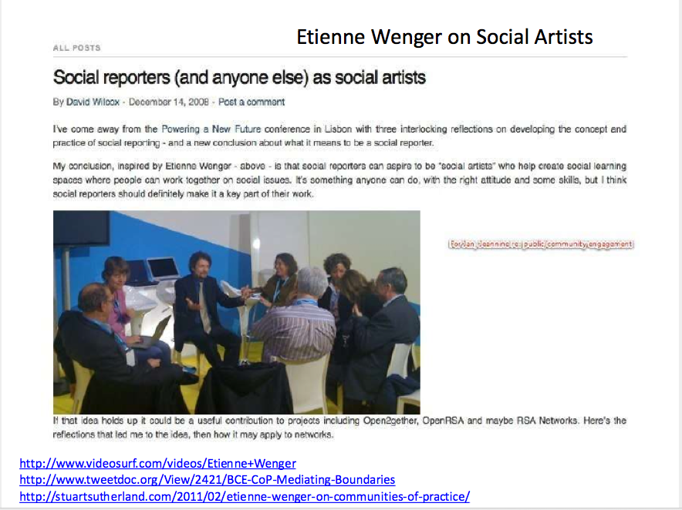
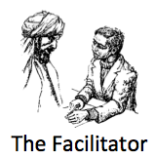
http://www.slideshare.net/choconancy/change11-mooc-session-october-31

Slide 28
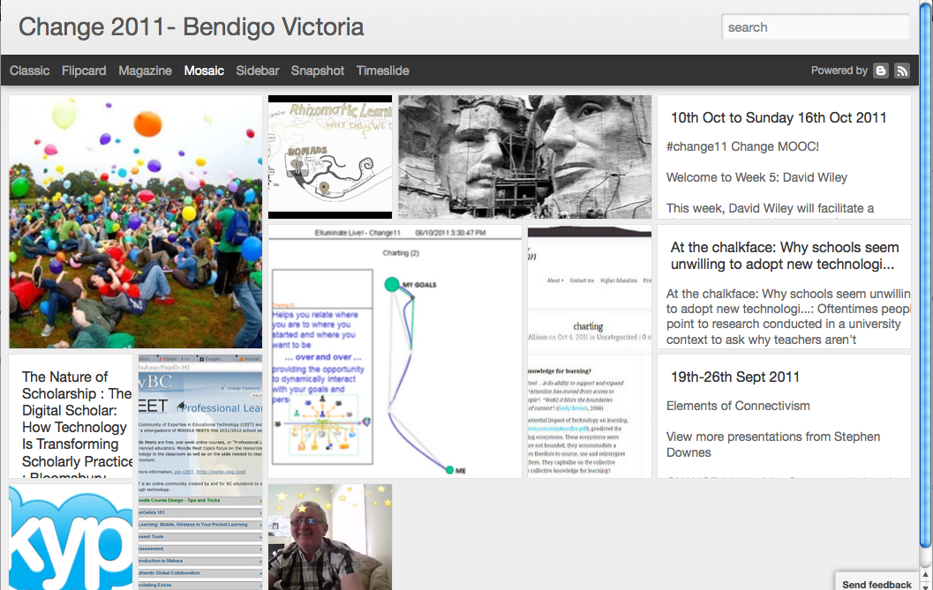

http://change2011inbendigovictoriaaustralia.blogspot.com/
The Conversationalist
Notes:
Change2011 skypers group
Skype

Slide 29

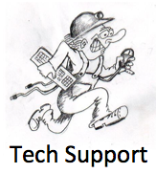
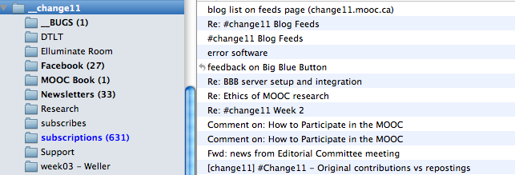

Slide 30

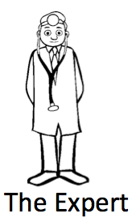
4 expert
4

Slide 31
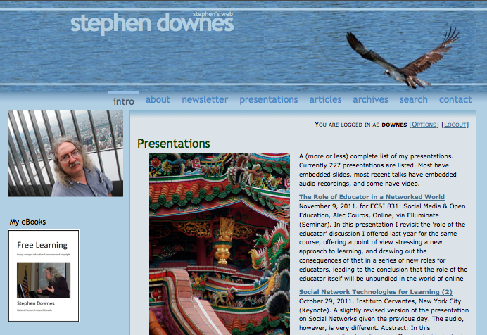
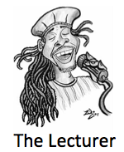
http://www.downes.ca/me/presentations.htm

Slide 32


http://change.mooc.ca/recordings.htm
Notes:
Conferencing environments:
BBB
Fuze
WizIQ
Adobe Connect
Blackboard Collaborate

Slide 33


http://cogdogblog.com/

Slide 34



http://www.livestream.com
Notes:
Also http://www.ustream.tv

Slide 35


Slide 36



http://fm.schmoller.net/
Notes:
Problm solving
presence
rhizomes

Slide 37



https://www.ai-class.com/

Slide 38



http://www.learninganalytics.net/
http://erikduval.wordpress.com/2011/11/08/the-speed-of-tech-owd11/
Notes:
analytics

Slide 39

http://www.downes.ca

